Slide 1

Impact of Climate Change and Aquatic Salinization
on Mangrove Species and Poor Communities
in the Bangladesh Sundarbans
Susmita Dasgupta
Istiak Sobhan
David Wheeler
Development Research Group
Environment and Energy Team
June 2016

Slide 2
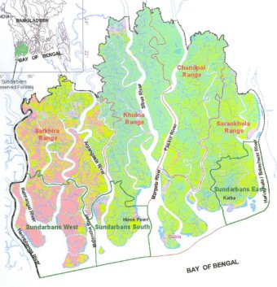
Map of the Bangladesh Sundarbans

Slide 3
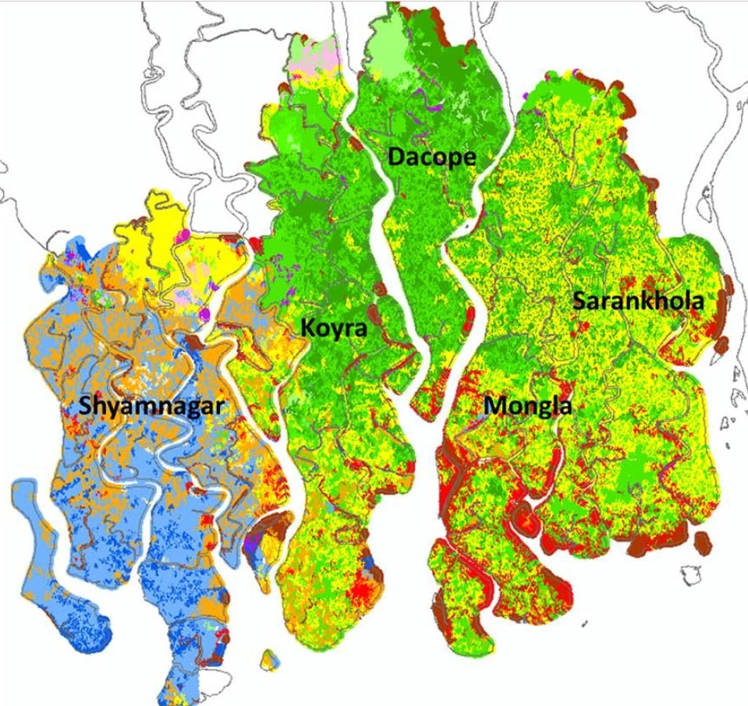
Salt water intrusion into Mangrove species
2012

Slide 4
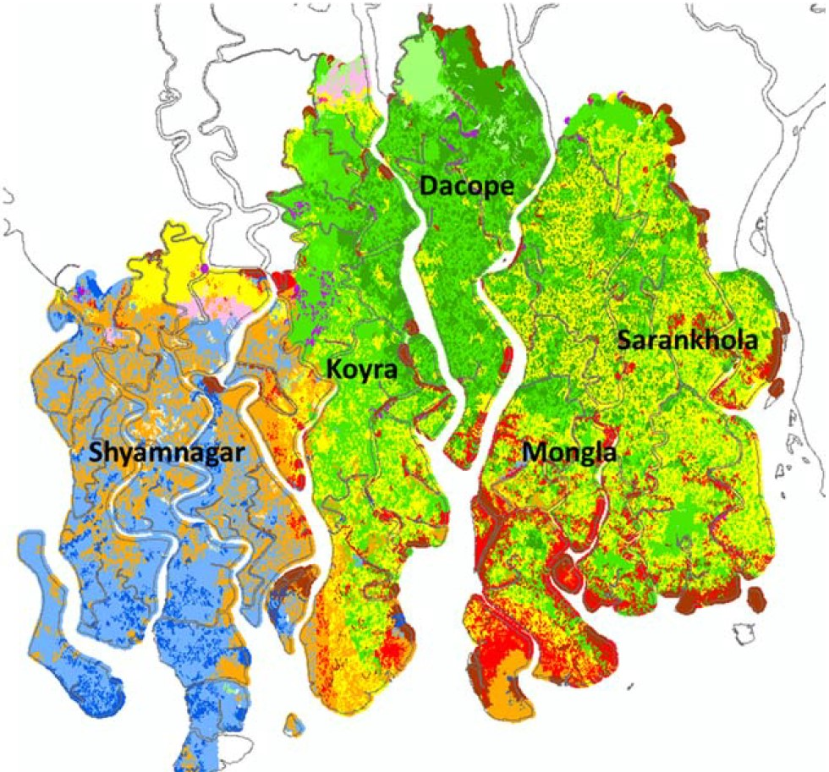
Salt water intrusion into mangrove species
2050

